Slide 1

ALZHEIMER SYNDROME
RECOGNITION USING DENSENET FOR MULTIMODAL ANALYSIS
TEAM MEMBERS GUIDED BY
KIRTHICK SAKTHI V (21CS046) Mrs. S. SUJITHA AP/CSE
MANIKANDAN L (21CS055)
MANOJKUMAR K (21CS056)

Slide 2
OBJECTIVE
To accurately predicting a model for Alzheimer's disease using a multimodal dataset that integrates various clinical, neuroimaging, and genetic features.
To develop tools that can predict who might be at higher risk. With these predictions, able to identify individuals symptoms before appear.
To start early interventions, such as treatments or lifestyle changes, to help delay or prevent the disease and improve quality of life.
To improve early detection and imaging technologies like MRI, PET, and CT scans.

Slide 3
ABSTRACT
Alzheimer's syndrome is classified using a deep learning-based leverages MRI brain images. By utilizing a pre-trained DenseNet model, it classifies brain scans into four categories: Non-Demented, Very Mild Demented, Mild Demented, and Moderate Demented.
Convolutional Neural Networks play a crucial role in Alzheimer's Syndrome diagnosis through MRI scan analysis.
A disease is identified in multimodal analysis by integrating different data types, like medical imaging, genetic information, analyzing 3D/2D images, MRI, and PET scans.
A deep learning model is proposed for Alzheimer's disease prediction, integrating multimodal imaging, accurate diagnosis, classify the stage of the disease and improve accuracy.

Slide 4
LITERATURE SURVEY
Paper Title | Author | Journal Name | Year | Key Points
Alzheimer’s Disease and Mild Cognitive Impairment Detection Using MRI With Efficient Receptive Field and Enhanced Multi-Axis Attention Fusion. | UTTAM KHATRI | IEEE Journal of Biomedical and Health Informatics. | 2024 | Detect Alzheimer's and Mild Cognitive Impairment early.
Multimodal 3D Deep Learning for Early Diagnosis of Alzheimer’s Disease. | SEUNG KYU KIM | IEEE Transactions on Neural Networks and Learning Systems | 2024 | Multimodal 3D deep learning provides a faster and more accurate way to diagnose AD.
Alzheimer's Diseases Detection by Using Deep Learning Algorithms: A Mini-Review | SUHAD AL-SHOUKRY, TAHA H. RASSEM | IEEE Transactions on Medical Imaging | 2023 | Deep learning can help identify AD at an earlier stage.
A Review on Alzheimer’s Disease Through Analysis of MRI Images Using Deep Learning Techniques. | BATTULA SRINIVASA RAO | IEEE XPLORE | 2023 | Detecting Alzheimer Disease early by analyzing MRI scans using deep learning.

Slide 5
Paper Title | Author | Journal Name | Year | Key Points
Early Diagnosis of Alzheimer’s Disease Using 18F-FDG PET With Soften Latent Representation | ABDUL REHMAN, MYUNG-KYU Y | IEEE Journal of Medical Imaging and Health Informatics | 2023 | Helps in better feature extraction, reducing noise and enhancing model performance.
Clinical diagnosis of Alzheimer’s disease | M. Folstein | IEEE Transactions on Cognitive and Developmental Systems | 2022 | Provides a consistent framework for diagnosing AD improving accuracy across clinics.
Generalizable deep learning model for early Alzheimer’s disease detection from structural MRIs | V. Masurkar | IEEE Transactions on Neural Networks and Learning Systems | 2022 | The model aims to work across various populations and MRI settings, improving its practical applicability.
Alzheimer’s disease detection from structural mri using fusion transformer. | R. Kushol | IEEE Transactions on Medical Imaging | 2021 | Combines multiple brain regions and features for more accurate and holistic analysis.

Slide 6
EXISTING SYSTEM
The existing system integrates cognitive impact , biomarkers, neuroimaging, and Imaging Data.
Cognitive Impact: Mild cognitive impairment, with slight challenges in planning, problem-solving, or organizing tasks.
Biomarkers: Blood and spinal fluid (CSF) tests to detect substances like amyloid-beta, tau, and neurofilament light chain for studying Alzheimer's disease at a molecular level.
Imaging Data: ADNI collects a wide range of brain imaging data, including MRI scans to study brain changes associated with Alzheimer's disease.
Neuroimaging: Analyzing large amounts of data requires advanced technology and expertise. Different hospitals use different scanning methods, making results inconsistent.

Slide 7
PROPOSED SYSTEM
Multimodal Data Integration: The system integrates MRI scans, PET scans, and clinical data (such as cognitive assessments and genetic information) for comprehensive Alzheimer's disease recognition.
Deep Learning Models: Advanced neural networks improve accuracy in predicting Alzheimer's from large datasets.
Multimodal Fusion: A fusion network combines features from DenseNet-extracted imaging data and Multimodal fusion in clinical data to enhance diagnostic accuracy and robustness.
DenseNet Architecture: The DenseNet algorithm is utilized for its efficient feature and enabling the ability to pass information easily between layers in the multimodal data.
Advancements in Neuroimaging Techniques: Exploration of how imaging technologies like MRI, PET, and CT scans evolved over the years to better capture brain changes.

Slide 8
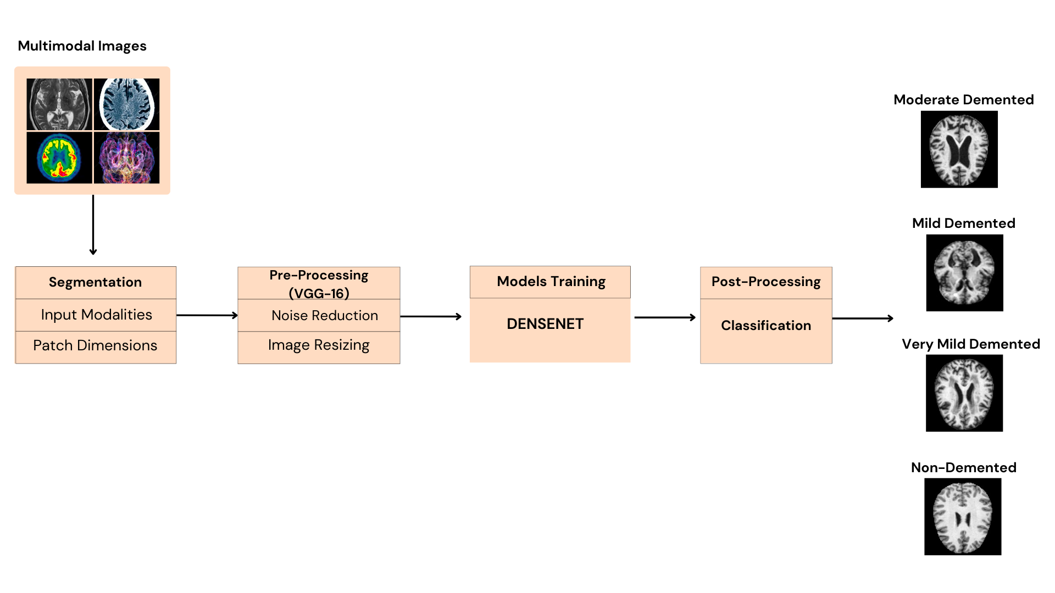
FUNCTIONAL DIAGRAM

Slide 9
MODULES DESCRIPTION
Multimodal Image Input:
The process begins with the collection of brain scan images from different techniques like MRI, PET and CT Scans. These images provide important details about the brain’s structure and function.
Segmentation:
The images are divided into smaller parts to focus on the important brain regions. This step helps in better analyzing the affected areas.
Pre-Processing (VGG-16):
The images are cleaned by removing noise and resized to a standard size. The VGG-16 Modal is used to pick out key features from the images, making it easier for the AI to recognize patterns.

Slide 10
MODULES DESCRIPTION
Modal Training (DenseNet):
The processed images are then fed into a DenseNet Modal, which is trained to identify different stages of Alzheimer’s disease. The modal learns from many examples to improve its accuracy in classification.
Post-Processing and Classification:
Finally, the trained modal classifies the images into four categories: Moderate Demented, Mild Demented, Very Mild Demented, and Non-Demented. This helps doctors understand the stage of the disease and make better treatment decisions.

Slide 11
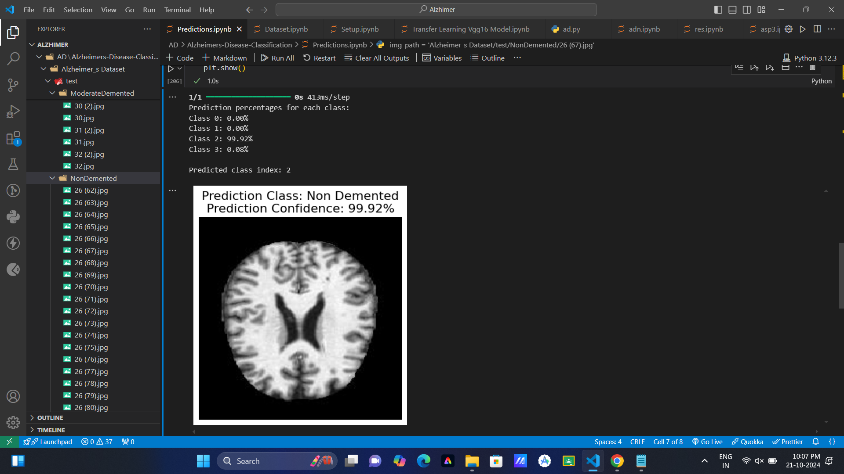
FINAL OUTPUTS

Slide 12
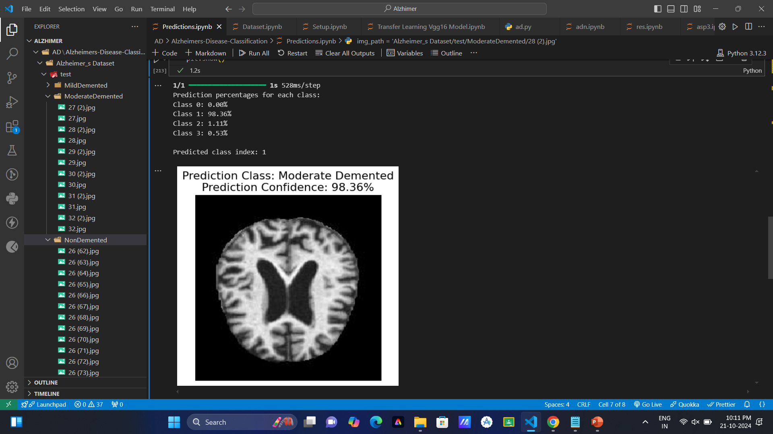

Slide 13
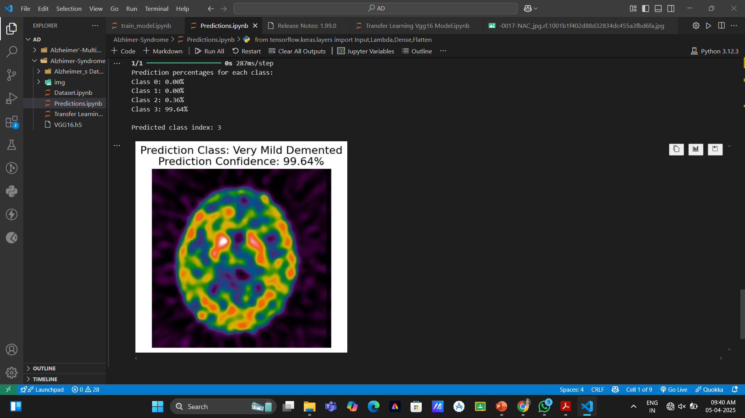

Slide 14
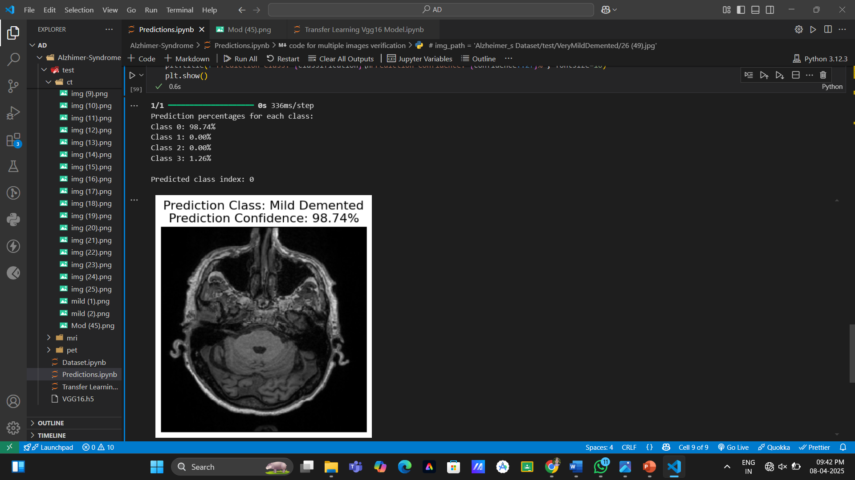

Slide 15
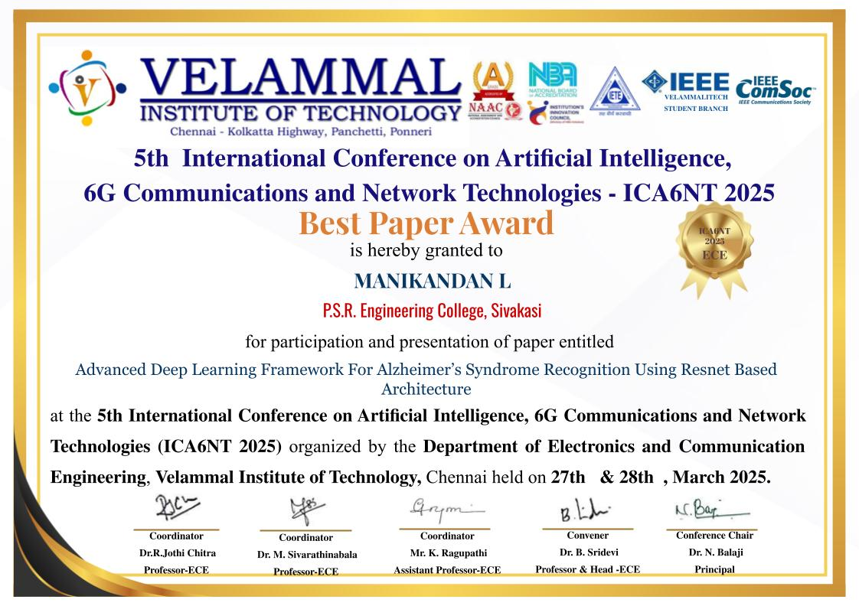
PROJECT OUTCOMES

Slide 16
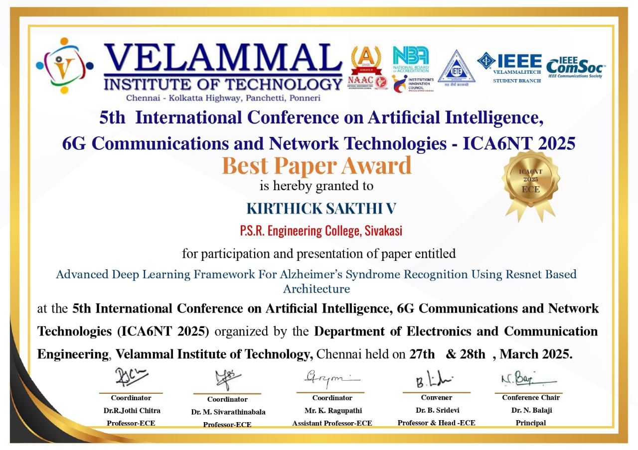

Slide 17
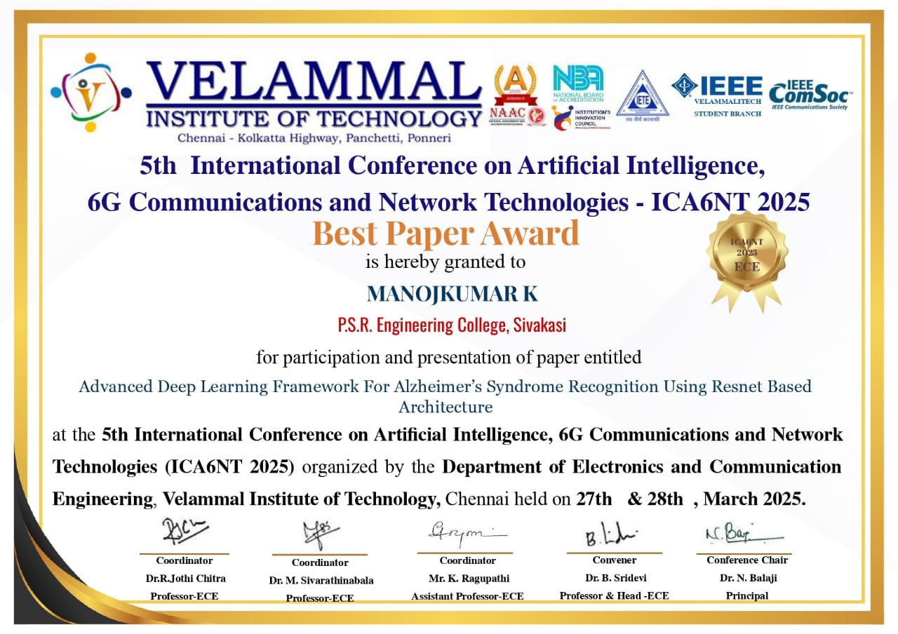

Slide 18
CONCLUSION
Alzheimer's Syndrome progresses from mild cognitive impairment to severe memory loss and dependency over four stages. Early diagnosis and intervention in the mild stage can help slow its progression. As the disease advances, comprehensive care and support become crucial for managing symptoms and ensuring multimodal analysis.
Highly effective model in this study that utilizes the self-attention mechanism to classify multimodal data associated with Alzheimer’s disease. Segmentation of brain MRI,PET,CT and 3D scans helps in their interpretation and categorization for diseases like Alzheimer’s.

Slide 19
REFERENCES
Z. Huang, X. Zhu, M. Ding, and X. Zhang, ‘‘Medical image classification using a light-weighted hybrid neural network based on PCANet and DenseNet,’’ IEEE Access, vol. 8, pp. 24697–24712, 2020.
R. K. Mishra, S. Urolagin, J. A. A. Jothi, A. S. Neogi, and N. Nawaz, ‘‘Deep learning-based sentiment analysis and topic modeling on tourism during COVID-19 pandemic,’’ Frontiers Comput. Sci., vol. 3, pp. 1–10, Nov. 2021.
Z. Pei, Y. Gou, M. Ma, M. Guo, C. Leng, Y. Chen, and J. Li, ‘‘Alzheimer’s disease diagnosis based on long-range dependency mechanism using convolutional neural network,’’ Multimedia Tools Appl., vol. 81, no. 25, pp. 36053–36068, Oct. 2022.
R. Gautam and M. Sharma, ‘‘Prevalence and diagnosis of neurological disorders using different deep learning techniques: A meta-analysis,’’ J. Med. Syst., vol. 44, no. 2, pp. 1–24, Feb. 2020.
M. Aparna and B. Srinivasa Rao, ‘‘Xception-FractalNet: Hybrid deep learning based multi-class classification of Alzheimer’s disease,’’ Comput., Mater. Continua, vol. 74, no. 3, pp. 6909–6932, 2023.
S. M. Anwar, M. Majid, A. Qayyum, M. Awais, M. Alnowami, and M. K. Khan, ‘‘Medical image analysis using convolutional neural networks: A review,’’ J. Med. Syst., vol. 42, no. 11, p. 226, Oct. 2018.

Slide 20
R. Azad, A. Kazerouni, M. Heidari, E. Khodapanah Aghdam, A. Molaei, Y. Jia, A. Jose, R. Roy, and D. Merhof, ‘‘Advances in medical image analysis with vision transformers: A comprehensive review,’’ 2023, arXiv:2301.03505.
K. Han, Y. Wang, H. Chen, X. Chen, J. Guo, Z. Liu, Y. Tang, A. Xiao, C. Xu, Y. Xu, Z. Yang, Y. Zhang, and D. Tao, ‘‘A survey on vision transformer,’’ IEEE Trans. Pattern Anal. Mach. Intell., vol. 45, no. 1, pp. 87–110, Jan. 2023, doi: 10.1109/TPAMI.2022.3152247.
M. Raghu, T. Unterthiner, S. Kornblith, C. Zhang, and A. Dosovitskiy, ‘‘Do vision transformers see like convolutional neural networks?’’ 2021, arXiv:2108.08810.
G. Hcini, I. Jdey, and H. Dhahri, ‘‘Investigating deep learning for early detection and decision-making in Alzheimer’s disease: A comprehensive review,’’ Neural Process. Lett., vol. 56, no. 3, p. 153, Apr. 2024, doi: 10.1007/s11063-024-11600-5.
G. M. Hoang, U.-H. Kim, and J. G. Kim, ‘‘Vision transformers for the prediction of mild cognitive impairment to Alzheimer’s disease progression using mid-sagittal sMRI,’’ Frontiers Aging Neurosci., vol. 15, Apr. 2023, Art. no. 1102869.
H. Shin, S. Jeon, Y. Seol, S. Kim, and D. Kang, ‘‘Vision transformer approach for classification of Alzheimer’s disease using 18F-florbetaben brain images,’’ Appl. Sci., vol. 13, no. 6, p. 3453, Mar. 2023, doi: 10.3390/app13063453.

Slide 21
THANK YOU!...

